Slide 1
Logging and debugging

Slide 2
Agenda
Using Log4Net
Debugging with Visual Stidio
Q&A

Slide 3
Using Log4Net
Log4Net Overview
Verify target environment
Add Log4Net library
Create configuration file
Logging initialization
Add logging code
Appender
Log levels
Layout
Filter overview

Slide 4
Log4Net Overview
Log message in any place of code
Control many kinds of output by appenders
Customize the logging behavior for a specific code part
Filter the log message by log level, keyword
Format the output message by log layout

Slide 5
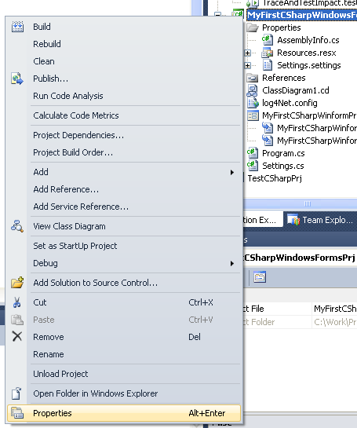
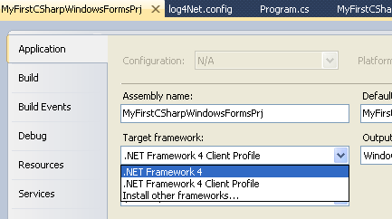
Verify target environment

Slide 6
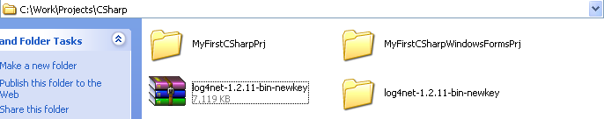
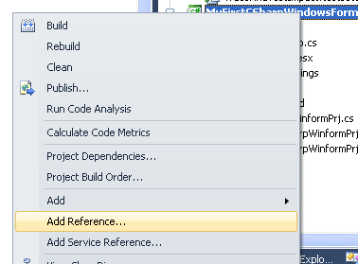
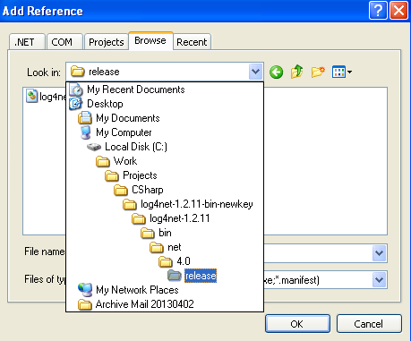
Add Log4Net library

Slide 7
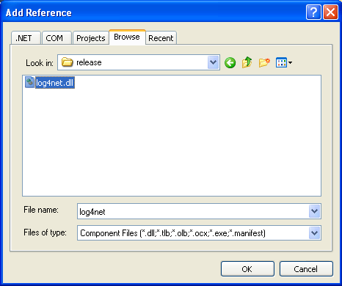
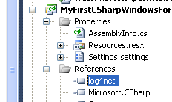
Add Log4Net library(cont.)

Slide 8
Create configuration file
Add a new configuration file
Register to Assembly
Main structure
Appender Section
Logger Section

Slide 9
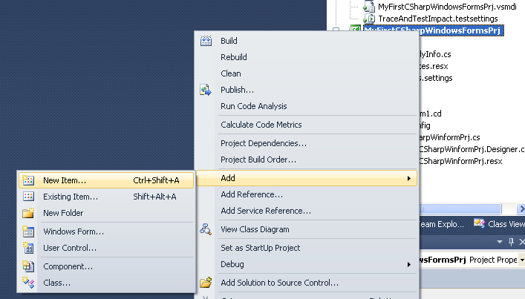
Create configuration file(cont.)

Slide 10
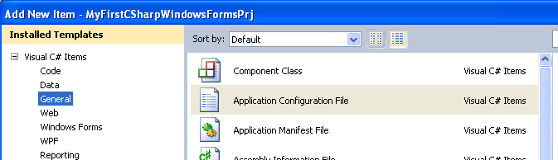
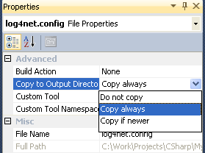
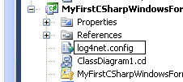
Create configuration file(cont.)
Create file name log4net.config
Notes:
Add log4net config file to the root folder

Slide 11
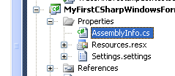
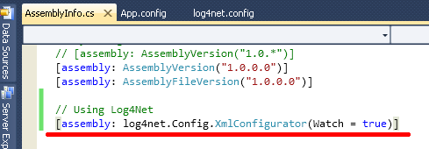
Create configuration file(cont.)
Notes:
Register to Assembly

Slide 12

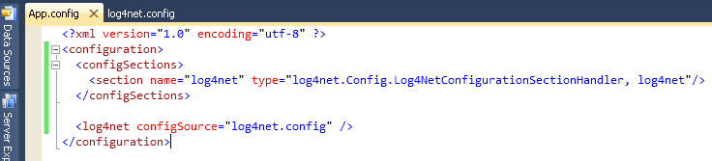
Create configuration file(cont.)
Notes:
Register to app.config: configSection and log4net configuration file

Slide 13
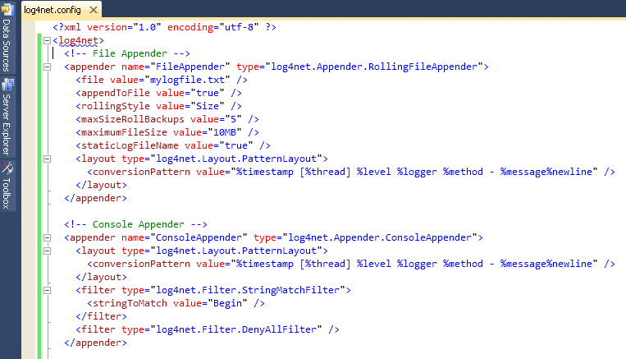
Create configuration file(cont.)
Notes:
Main structure: Appenders and loggers
Appender Section: File rolling and console

Slide 14
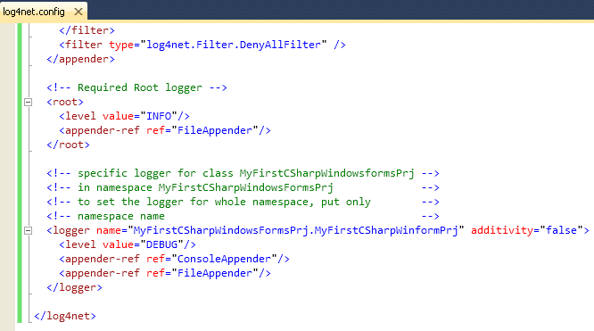
Create configuration file(cont.)
Notes:
Logger Section: Root required and specific logger is optional

Slide 15
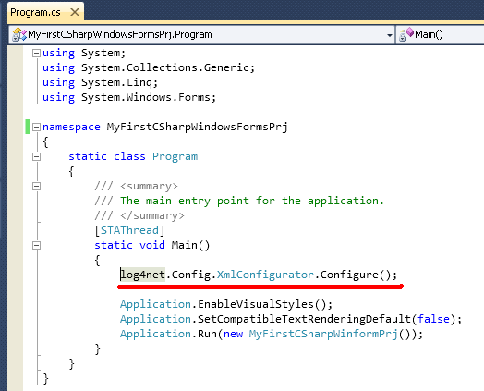
Logging initialization

Slide 16
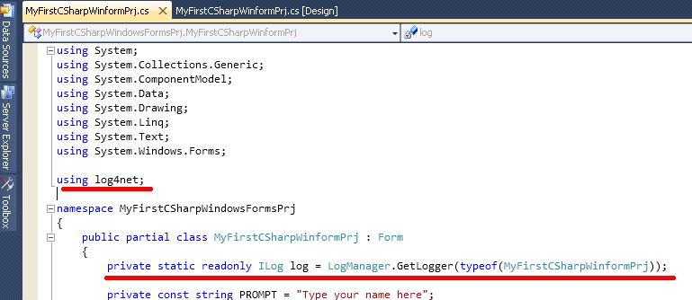
Logging initialization(cont.)

Slide 17
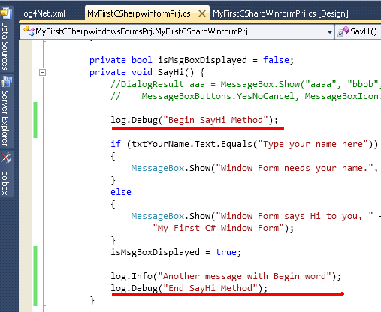
Add logging code

Slide 18
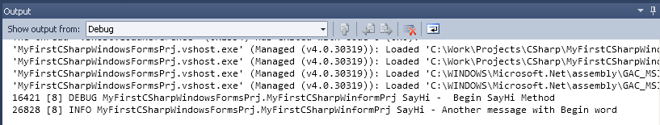
Output
Console output

Slide 19
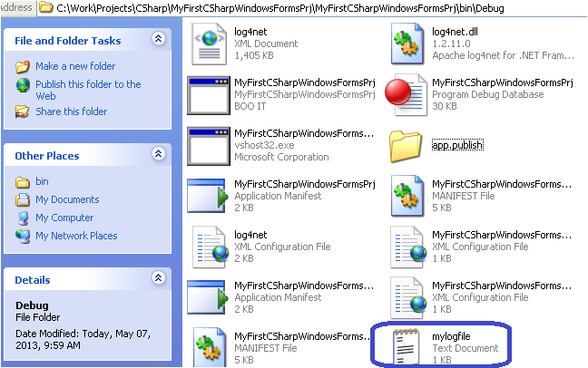
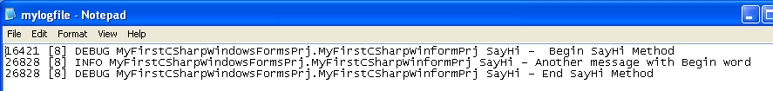
Output(cont.)
File output

Slide 20
Appender

Slide 21
Appender(cont.)
File rolling
Console
File
AdoNet – to Database
AspNet – to Asp.Net trace context
Trace – to .Net trace system
EventLog – to Windows event log
SMTP – by email
NetSend – by Windows messenger

Slide 22
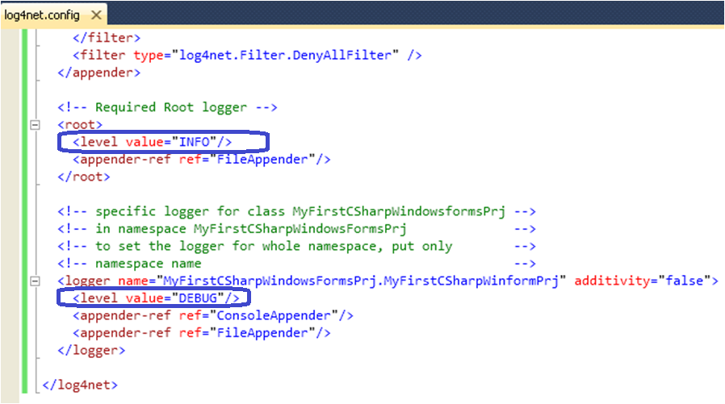
Log Levels

Slide 23
Log Levels(cont.)
OFF
ALL
DEBUG
INFO
WARN
ERROR
FATAL
Notes:
Co nhieu phuong tien de log so voi console writeline

Slide 24
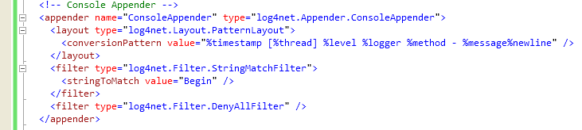
Layout

Slide 25
Layout(cont.)
ExceptionLayout
PatternLayout
RawTimeStampLayout
RawUtcTimeStampLayout
SimpleLayout
XmlLayout
XmlLayoutSchemaLog4j
Notes:
ExceptionLayout Renders the exception text from the logging event.
PatternLayout Formats the logging event according to a flexible set of formatting flags.
RawTimeStampLayout Extracts the timestamp from the logging event.
RawUtcTimeStampLayout Extracts the timestamp from the logging event in Universal Time.
SimpleLayout Formats the logging event very simply: [level] - [message]
XmlLayout Formats the logging event as an XML element.
XmlLayoutSchemaLog4j Formats the logging event as an XML element that complies with the log4j event dtd.

Slide 26
Filter

Slide 27
Filter(cont.)
DenyAllFilter
LevelMatchFilter
LevelRangeFilter
LoggerMatchFilter
PropertyFilter
StringMatchFilter
Notes:
Attention to filter order
DenyAllFilter Drops all “other” logging events.
LevelMatchFilter An exact match to the event's level.
LevelRangeFilter Matches against a range of levels.
LoggerMatchFilter Matches against a the start of the logger name.
PropertyFilter Matches a substring from a specific property value.
StringMatchFilter Matches a substring from the event's message.

Slide 28
Debugging with Visual Studio
Debug toolbar
Breakpoint
Add watch
Change values on-the-fly
Edit and continue
Conditional breakpoints
Command Window

Slide 29
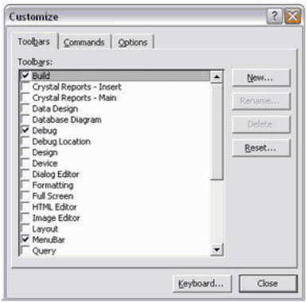
Debug toolbar
Choose Tools from the main menu, next choose Customize. The Customize dialog should now appear.

Slide 30

Debug toolbar(cont.)
Debug toolbar is appear on menu toolbar.

Slide 31
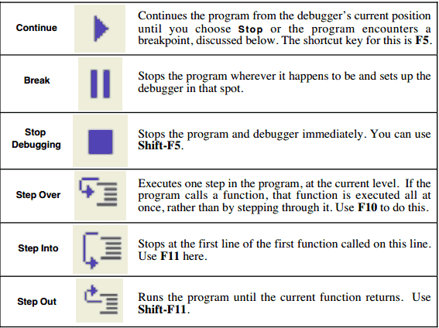
Debug toolbar(cont.)

Slide 32
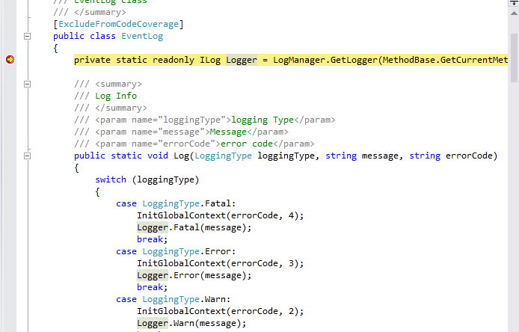
Breakpoint

Slide 33
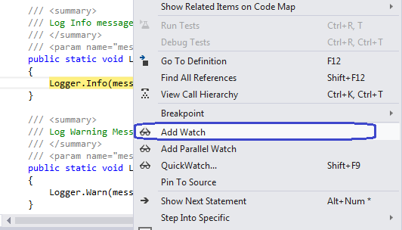
Add watch
Start run debug mode to the breakpoint. Right click on variable to use view variable’s value. Choose Add Watch on the menu.

Slide 34
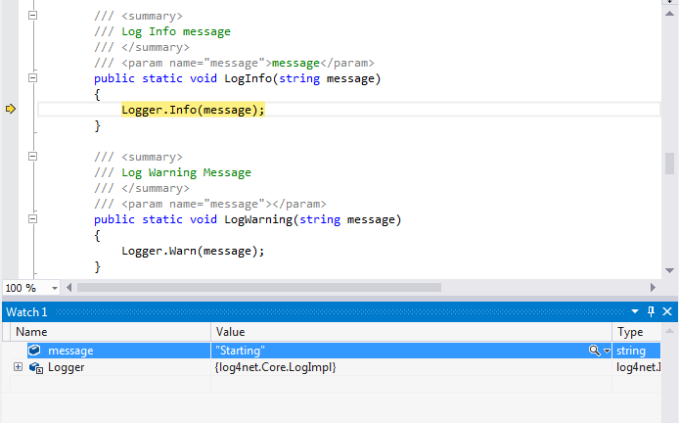
Add watch(cont.)
We can view the value of variables, objects in the Watch window bellow.

Slide 35
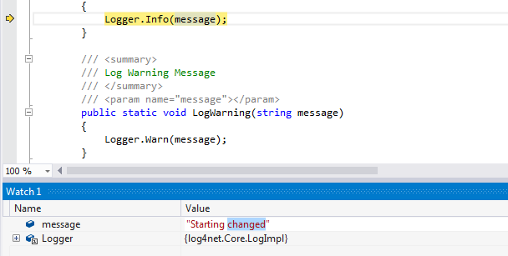
Change values on-the-fly
During the debugging, we can change value of variable. Double-click on the value cell of variable and change the value.

Slide 36
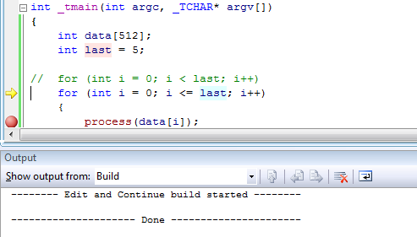
Edit and continue
During the debugging, Visual Studio will allow to modify source code and continue debugging without restart application.

Slide 37
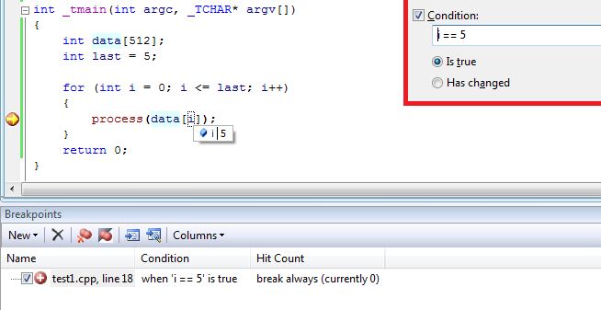
Conditional breakpoints
During the debugging, Visual Studio will allow to modify source code and continue debugging without restart application.

Slide 38
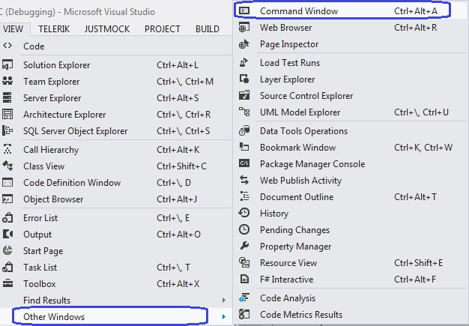
Command Window
To see to Command Window, open View menu, choose Other Windows, then choose Command Window.

Slide 39
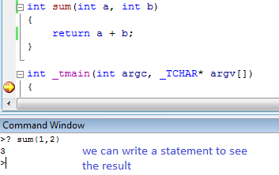
Command Window(cont.)
In Command Window, we can write C# statement to check see data.

Slide 40
Q&A
Question & Answer
Notes:
http://msdn.microsoft.com/en-us/data/dd363565.aspx

